Slide 1
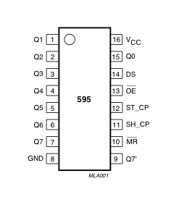
Shifting out (Siljish)

Slide 2
Siljish (shifting out) va 74hc595 chip
Siz Arduino platasida pinlarni ko’paytirish va uni smenali registrlar bilan kengaytirishingiz kerak. Bu misol 74HC595 ga asoslangan. 74HC595 chiqish latchi 3 simli 8-bitli ketma-ket yoki parallel chiqib ketish registri deb ataladi. Boshqacha qilib aytganda, uni bir vaqtning o'zida 8 ta chiqishni nazorat qilish uchun ishlatishingiz mumkin.

Slide 3
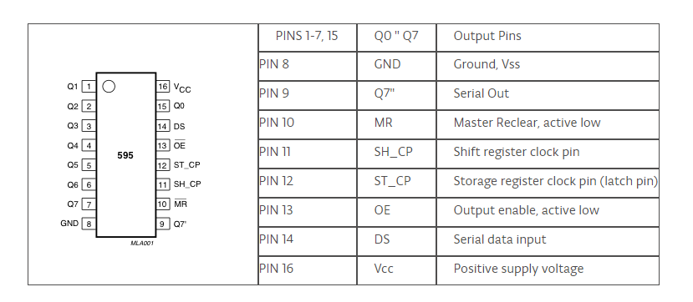
74HC595 Shifting out chip.

Slide 4
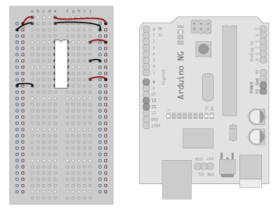
Arduino platformasida ulanishi
Ulanish o’tkazgichlari:
GND (pin 8) to ground,
Vcc (pin 16) to 5V
OE (pin 13) to ground
MR (pin 10) to 5V

Slide 5
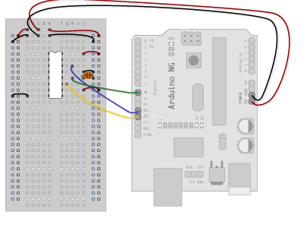
Arduinoga ulash
DS (pin 14) - Ardunio DigitalPin 11 (ko’k sim) ga
SH_CP (pin 11) –Ardunio DigitalPin 12 (sariq sim) ga
ST_CP (pin 12) - Ardunio DigitalPin 8 (yashil sim)ga

Slide 6
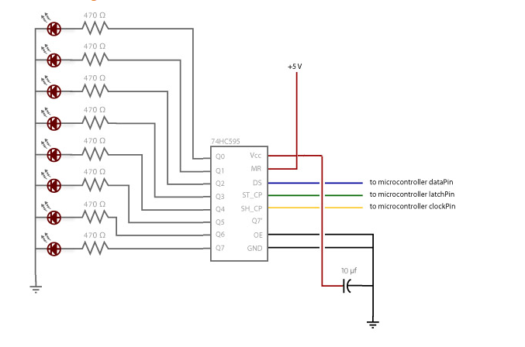
8 bit uchun LED larni ulash

Slide 7
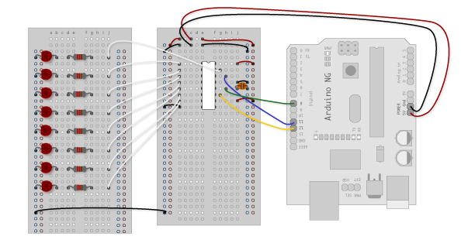

Slide 8
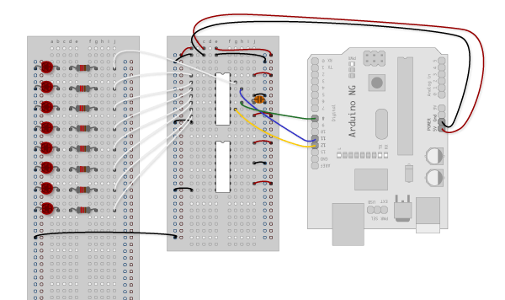
Shifting registrini ko’paytirish.

Slide 9
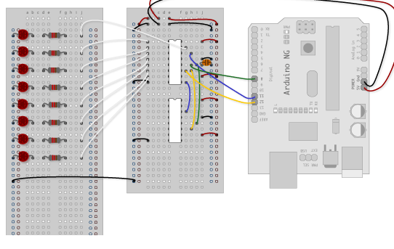

Slide 10
